Slide 1


First, prepare your data
Dr Simone Cuff
@SimoneMCuff
Research Associate,
Translational Immunology,
Cardiff University School of Medicine
cuffsm@cf.ac.uk

Slide 2

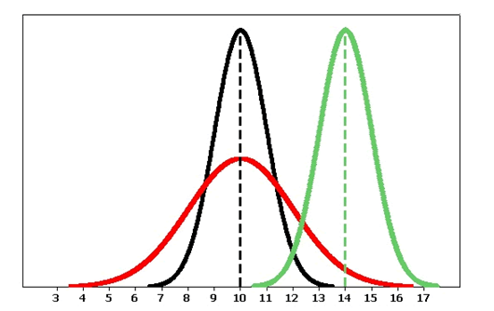

Slide 3

Real world data
Inconsistent
Sometimes not even there
Noisy
Messy

Slide 4


Data pre-processing
Image credit: Freestock.com

Slide 5
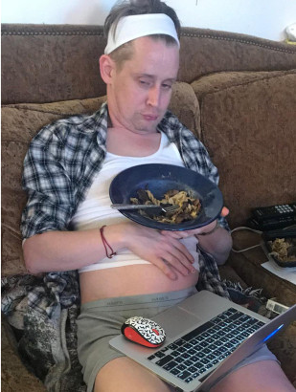
Data pre-processing

Slide 6
Data pre-processing
Image credit: Freestock.com

Slide 7
Basic steps of data pre-processing
Understand where your data have come from.
Look at your data graphically
Check and deal with missing values
See what needs to be a categorical value
Transform and normalise data as needed
Now you have a dataset. Feel free to analyse at will
Disclaimer:
This topic is massive. This talk is little. You may have a favourite method. I may not cover it in my little talk. Apologies to your favourite method.

Slide 8
Basic steps of data pre-processing
Understand where your data have come from.
Look at your data graphically
Check and deal with missing values
See what needs to be a categorical value
Transform and normalise data as needed
Now you have a dataset. Feel free to analyse at will
Disclaimer:
This topic is massive. This talk is little. You may have a favourite method. I may not cover it in my little talk. Apologies to your favourite method.

Slide 9
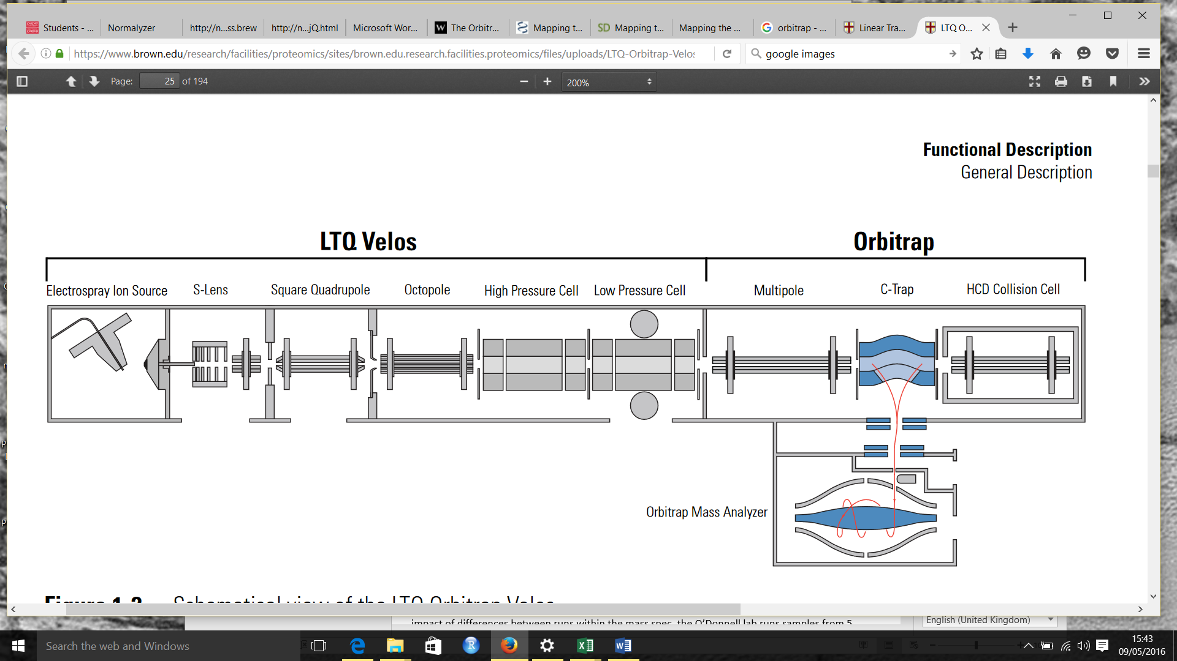
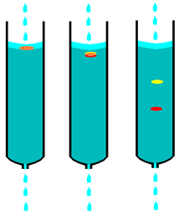
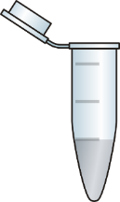
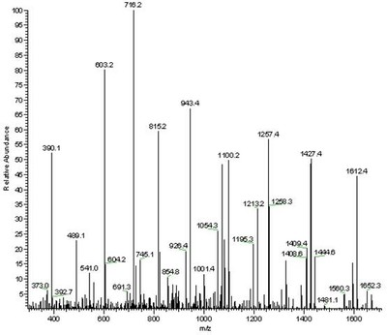
Lipid extraction from plasma
Column-based separation
High resolution mass spectrometry
Samples were plasma from patients of group A5 (n=14), E33 (n=22) and S33 (n=8), plus 5 QC controls from pooled control plasma.
Aim was to determine if there are differences between the patients.
Peak intensity (indicates amount of each molecule)
m/z ratio (identifies the molecule)
Notes:
This is the data that I will be referring to for most of my examples.

Slide 10
Lipid extraction from plasma
Column-based separation
High resolution mass spectrometry
Variation between patients.
Differences between operators
Minor protocol changes
Quirks of the Orbitrap
Environmental changes
(Pooled QC samples used to check)
Peak intensity (indicates amount of each molecule)
Mixture of above changes leading to software misidentification of peaks or missing peaks
LOTS OF ZEROES. SO MANY ZEROES.
m/z ratio (identifies the molecule)
Notes:
Remember to say that the height of the peak is referred to as its intensity and it is indicative of how much of a molecule is present

Slide 11
Basic steps of data pre-processing
Understand where your data have come from.
Look at your data graphically
Check and deal with missing values
See what needs to be a categorical value
Transform and normalise data as needed
Now you have a dataset. Feel free to analyse at will

Slide 12
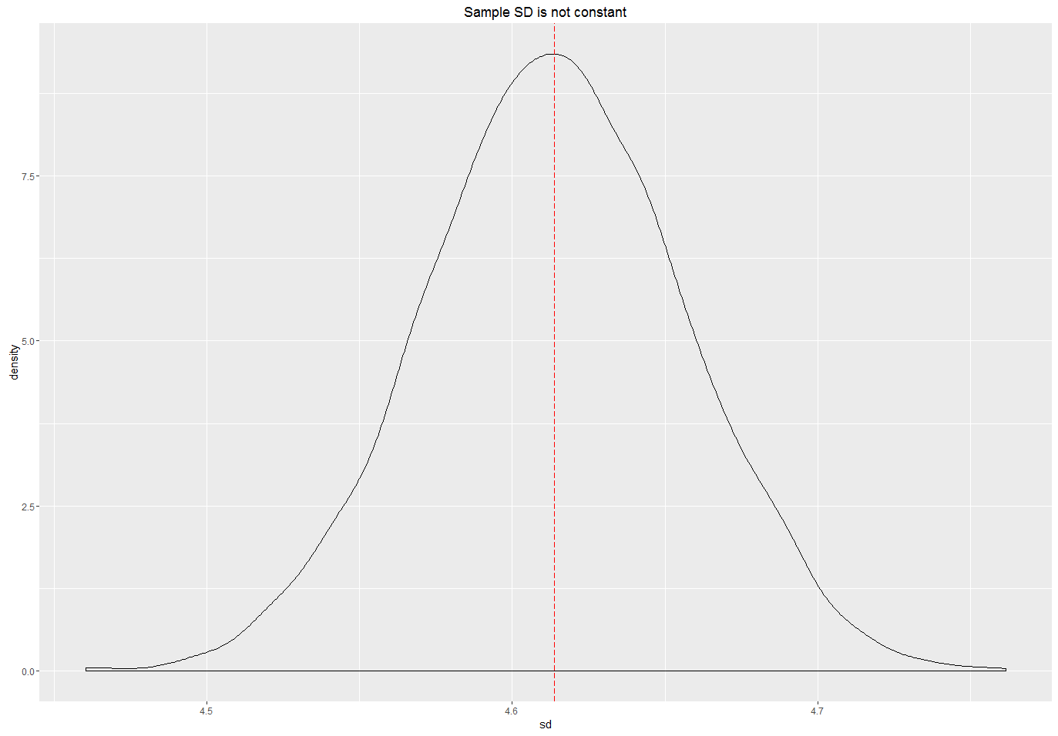
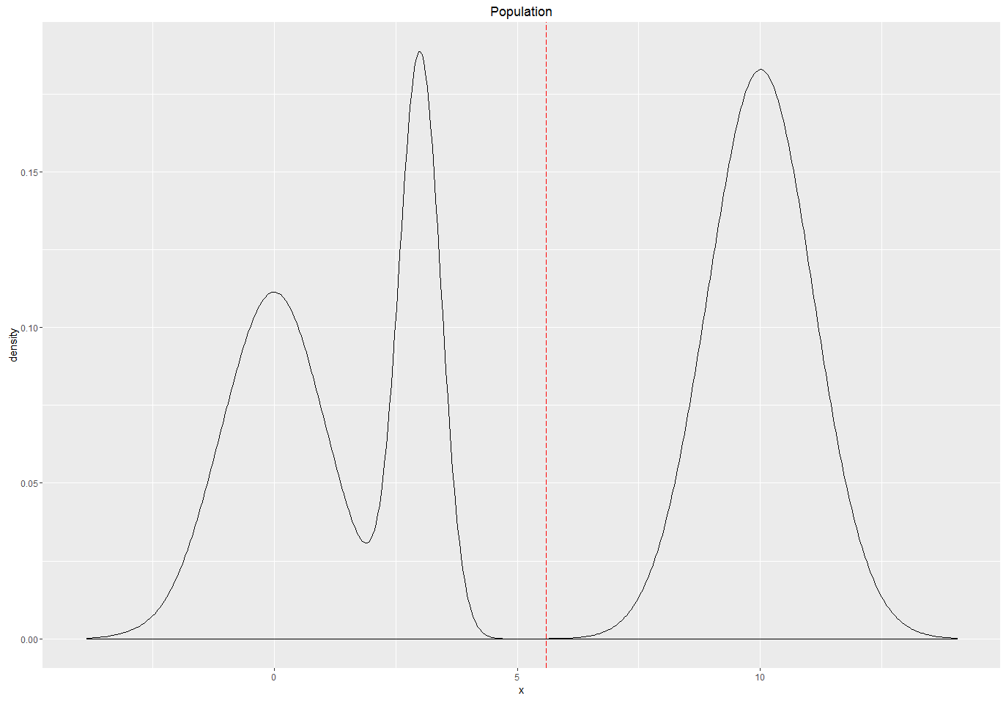
Always look at the data

Slide 13
Check your data graphically
Data consist of 25,891 possible peaks and their intensities from 49 samples.
Only 6,661 peaks found in all samples.
Samples had between 41-51% zeroes each.
Removed zeroes and transformed data to see if it formed a normal distribution.
Notes:
You don’t always need to remove the zeroes because sometimes you can use a zero-inflated poisson model or something like that if you know where your zeroes had come from. In this case they had come from a whole mishmash of reasons.

Slide 14
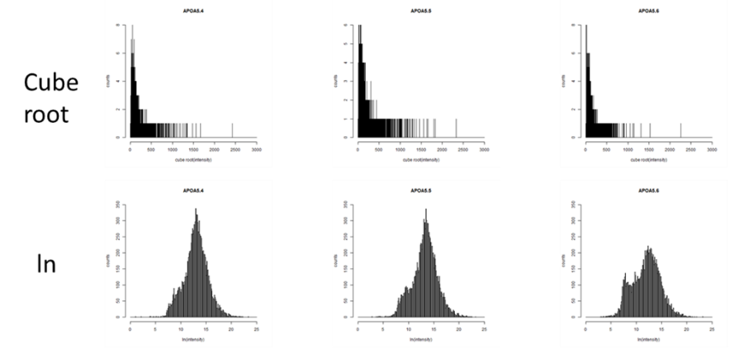
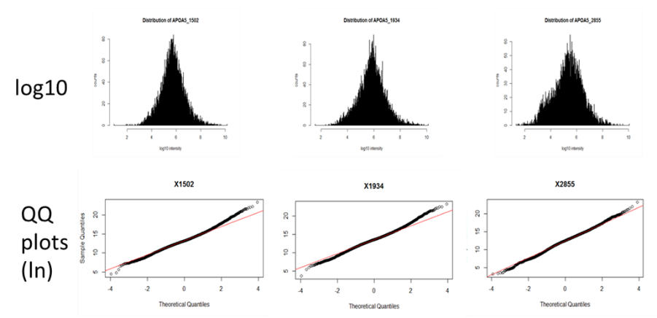
A5
E33
S33
Peak intensity
Package: stats v3.6.1
qqnorm()

Slide 15
Basic steps of data pre-processing
Understand where your data have come from.
Look at your data graphically
Transform data as needed
Check and deal with missing values
See what needs to be a categorical value
Normalise
Now you have a dataset. Feel free to analyse at will

Slide 16
Basic steps of data pre-processing
Understand where your data have come from.
Look at your data graphically
Transform data as needed
Check and deal with missing values
See what needs to be a categorical value
Normalise
Now you have a dataset. Feel free to analyse at will

Slide 17
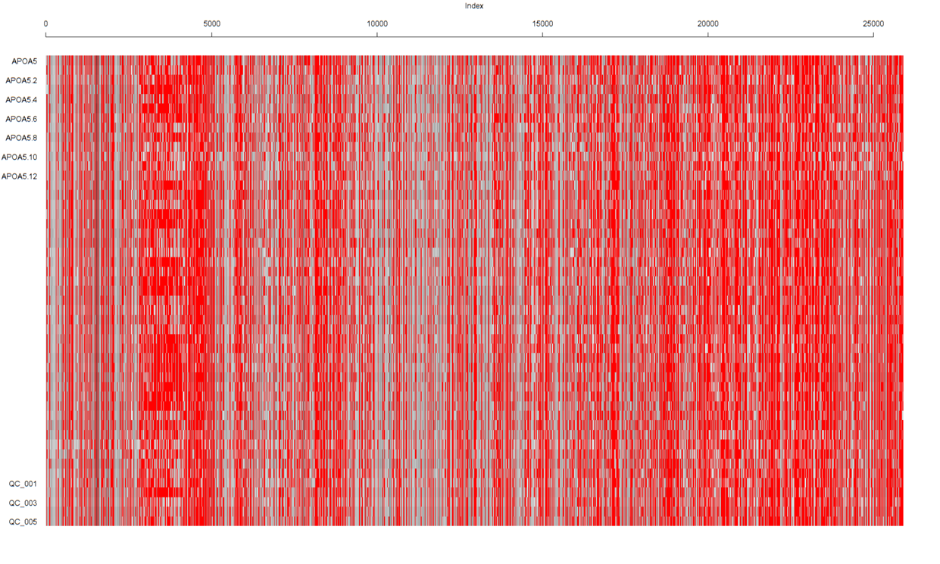
No detection
Low levels
High levels
Approx. 50% of values are zero or missing!
Individual samples
Package: VIM
matrixplot()
m/z ratio (identifies the molecule)
Notes:
The important points are that the zeroes don’t appear to be at random. You are not looking at static here: the zeroes tend to be clustered and be in the same place for most samples. This suggests that they may be present in only one sample, say as a result of a peak shifting slightly and so being measured as if it is a completely new peak. And I can tell you that the number of zeroes is the same for samples from different patient groups so it isn’t something to do with the pathology.

Slide 18
What does your zero mean?
0
There is nothing to measure.
The data are missing
Keep it!
“Missing not at random” (MNAR)
Informative zero
“Missing at random” (MAR) or “Missing Completely at Random” (MCAR)
ie non-informative zero
Drop or impute
Notes:
Missing at Random (MAR): Missing at random means that the fact a data point is missing is not related to the missing data, but it is related to some of the observed data
Missing Completely at Random (MCAR): Does what it says on the tin.
Missing not at Random (MNAR): The data is missing because it shouldn’t be there. The zero is in fact zero. It is still real data, it is just that its value is zero.
In the first two cases, it is safe to remove the data with missing values (sometimes), while in the third case removing observations with missing values can produce a bias in the model. So we have to be really careful before removing observations. Note that imputation does not necessarily give better results.

Slide 19
No detection
Low levels
High levels
Individual samples
m/z ratio (identifies the molecule)
Notes:
The important points are that the zeroes don’t appear to be at random. You are not looking at static here: the zeroes tend to be clustered and be in the same place for most samples. This suggests that they may be present in only one sample, say as a result of a peak shifting slightly and so being measured as if it is a completely new peak. And I can tell you that the number of zeroes is the same for samples from different patient groups so it isn’t something to do with the pathlogy.

Slide 20
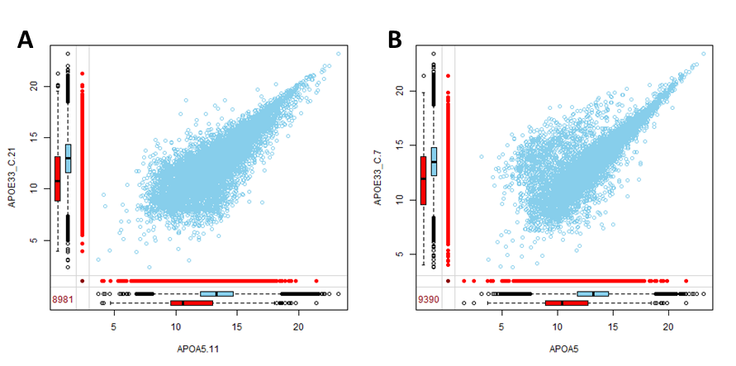
Peaks in E33-21 which match zeroes in A5-11
Peaks in E33-21 which match non-zeroes in A5-11
R package: VIM
marginplot()
Peak intensity
E33-21
# of peaks matched between the samples
Peak intensity
A5-11
Notes:
So margin plots are a great way of seeing whether your zeroes are at random. If they are random then their distribution should be the same as the distribution of the non-zeroes. If not, they may be not at random, so if you discard them you may be discarding valid data that just happens to be zero. You can see that the zeroes are not random. In fact the median is quite low. For the orbitrap the cutoff is usually 50,000, which is 10.82 on this natural log scale. It is really close to the median. So a lot of the zeroes are around this level, so they are probably corresponding with low abundance molecules that are just around the cutoff or may be background noise. That’s great, because those that are low in abundance anyway are unlikely to be really useful to us in this context.

Slide 21
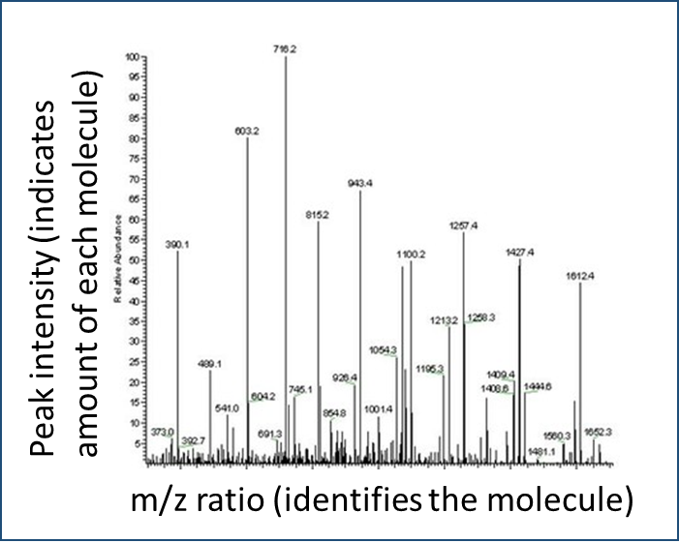
Notes:
So if you look here you can see that in fact many of the peaks are quite small, in fitting with what you can see on the margin plot.

Slide 22
To Impute or Not to Impute
Imputation
Allows you to keep all of your data -> preserves power
If zeroes are informative, you are replacing real data with incorrect data
Removing Data
All data present is real
Lose data
If zeroes are informative, then you will bias your input data by removing cases with zeroes

Slide 23
Analysis without imputation
Complete case analysis
Does what it says on the tin. Only keeps those samples for which there is complete data
Good for if a small amount of data is missing and you have a large number of samples.
You must be reasonably sure that your data are missing completely at random or you going to introduce bias.
Pairwise deletion
Analyses all cases in which the variables of interest are available.
Increases the power of the analysis
Different numbers of observations can contribute to different parts of your model, which can make it difficult to interpret.
Again, MCAR important!

Slide 24
Example dataset for deletion
 | Height (cm) | Weight (kg) | Species | Eye colour | Likes porridge
Dave | 180 | 85 | Human | Brown | Y
Kristen | 165 | 70 |  | Brown | N
Jeff | 5 | 0.02 | Mouse | Brown | Y
Melissa | 178 | 90 | Human | Green

Slide 25
Complete case analysis
 | Height (cm) | Weight (kg) | Species | Eye colour | Likes porridge
Dave | 180 | 85 | Human | Brown | Y
Kristen | 165 | 70 |  | Brown | N
Jeff | 5 | 0.02 | Mouse | Brown | Y
Melissa | 178 | 90 | Human | Green
Note: This can bias data. Now 50% of respondents are mice.

Slide 26
Complete Case Analysis
 | Height (cm) | Weight (kg) | Species | Eye colour | Likes porridge
Dave | 180 | 85 | Human | Brown | Y
Kristen | 165 | 70 |  | Brown | N
Jeff | 5 | 0.02 | Mouse | Brown
Melissa | 178 | 90 | Human | Green | Y
Note: Removal of not-at-random zeroes can also bias data. Here,
Jeff didn’t fill in the porridge-liking form and has now been removed. Mice are rubbish at filling out forms.

Slide 27
Pairwise analysis
 | Height (cm) | Weight (kg) | Species | Eye colour | Likes porridge
Dave | 180 | 85 | Human | Brown | Y
Kristen | 165 | 70 |  | Brown | N
Jeff | 5 | 0.02 | Mouse | Brown | Y
Melissa | 178 | 90 | Human | Green
Can compare height to weight irrespective of whether subjects like porridge

Slide 28
Pairwise analysis
 | Height (cm) | Weight (kg) | Species | Eye colour | Likes porridge
Dave | 180 | 85 | Human | Brown | Y
Kristen | 165 | 70 |  | Brown | N
Jeff | 5 | 0.02 | Mouse | Brown | Y
Melissa | 178 | 90 | Human | Green
Can complicate analyses when there are different numbers of samples in each group

Slide 29
Six imputation methods (I)
Replace with mean, median or mode
A bit rubbish as a method, but it is used so I am putting it out there.
Interpolation and extrapolation
Estimate the missing value from other values in the same individual
Good for longitudinal data
Eg a vet estimating thirst in diabetic dogs.

Slide 30

Imputation: mean, interpolation & extrapolation
4pm
6pm
8pm
10pm
12am
Time
Amount in water bowl
2L
0.5L
Notes:
There was 2L of water in the bowl at 4pm, 0.5L at 8pm but the vet nurse forgot to do the 6pm check.

Slide 31
Imputation: mean
4pm
6pm
8pm
10pm
12am
Time
Amount in water bowl
2L
0.5L
Amount in water bowl: other dogs staying overnight
2.0L
1.5L
1.5L
2.0L
1.8L
1.5L
1.0L
2.0L
1.6L
1.0L
0.8L
1.5L
1.6L
0.8L
0.8L
1.5L
1.6L
0.8L
0.8L
1.5L
Notes:
Imputation by mean is clearly not suitable.

Slide 32
Imputation: mean
4pm
6pm
8pm
10pm
12am
Time
Amount in water bowl
2L
1.6L
0.5L
1.2L
1.2L
Amount in water bowl: other dogs staying overnight
2.0L
1.5L
1.5L
2.0L
1.8L
1.5L
1.0L
2.0L
1.6L
1.0L
0.8L
1.5L
1.6L
0.8L
0.8L
1.5L
1.6L
0.8L
0.8L
1.5L

Slide 33
Imputation: interpolation
4pm
6pm
8pm
10pm
12am
Time
Amount in water bowl
2L
1.25L
0.5L
Notes:
1.25L is probably an OK imputed value.
Not always good though, particularly with extrapolation. At 12am there was more likely to be a sleeping dog than there was for there to be -1L in the water bowl.

Slide 34
Imputation: extrapolation
4pm
6pm
8pm
10pm
12am
Time
Amount in water bowl
2L
0.5L
-1L

Slide 35
Six imputation methods (I)
Replace with mean, median or mode
A bit rubbish as a method, but it is used so I am putting it out there.
Interpolation and extrapolation
Estimate the missing value from other values in the same individual
Can be good for longitudinal data

Slide 36
Six imputation methods (II)
Hot deck imputation
Find all other individuals who have similar values on other variables, then randomly choose one of their values on the missing variable (k-nearest neighbour method is very similar)
Cold deck imputation
The same, but without the random component.
Regression imputation
Regress the missing variable based on the other variables.
Stochastic regression imputation
Predict the value using regression and add a random residual value.
Notes:
.

Slide 37
Multiple vs single imputation
Major problem with single imputation is that it underestimates variation
Can be fixed using multiple imputation (use of more than one method).
Implementation in R: MICE package (multiple imputation using chained equations) and others.

Slide 38
Which to do?
Look at the nature of your zeroes.

Slide 39
Notes:
So what did I do in the case of the peak intensities? I looked at my data to try to identify which were real zeroes and which were missing at random.

Slide 40
Case study in zeroes
What if we are looking at relative abundance? Then we need to exclude peaks which are not present in one of the groups.
A5 (n=14)
E33 (n=22)
S33(n=8 )
Minimum number of samples per A5/E33 group expressing the peak | No. of peaks excluded using this criteria
0 | 3,990
1 | 6,984
2 | 8,644
3 | 9,789
4 | 10,700

Slide 41
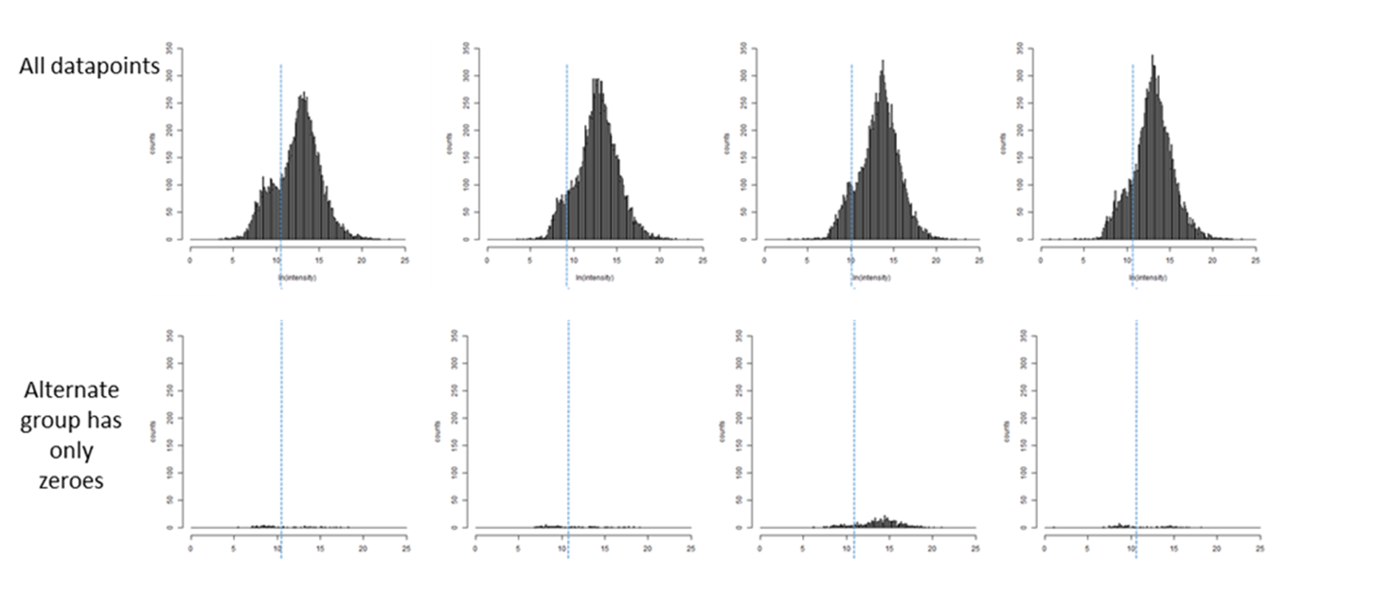
Distribution of discarded data
Discarded data

Slide 42
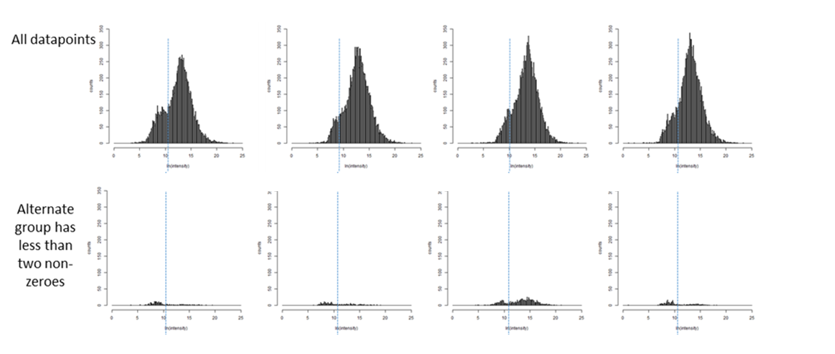
Distribution of discarded data
Discarded data

Slide 43
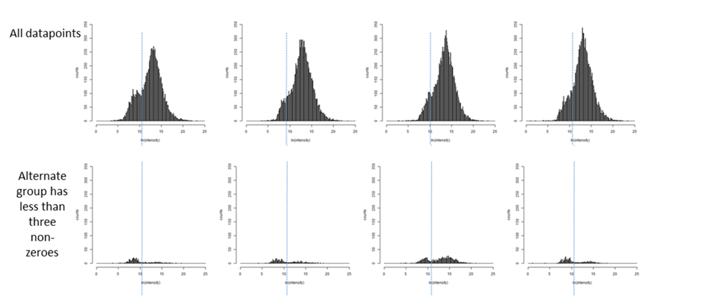
Distribution of discarded data
Discarded data

Slide 44
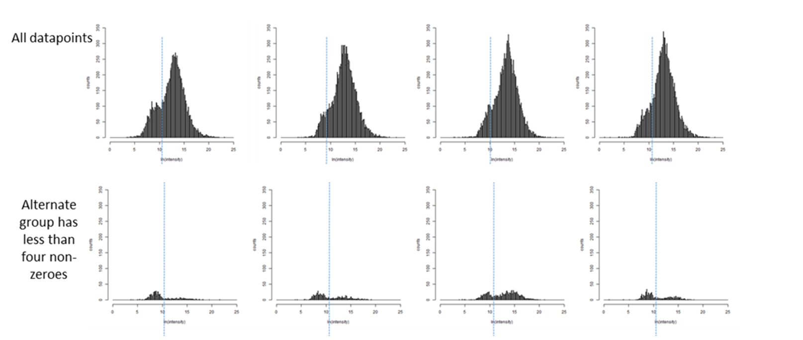
Distribution of discarded data
Discarded data

Slide 45
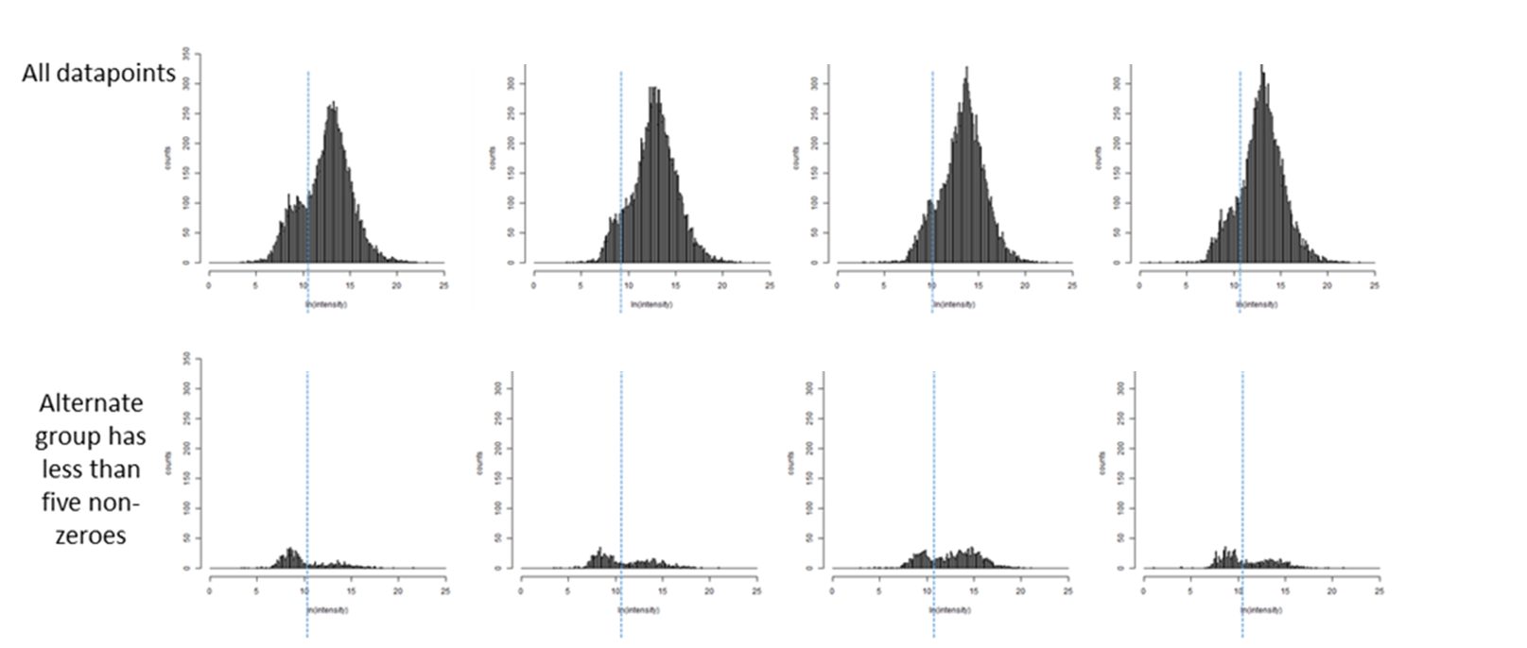
Distribution of discarded data
Discarded data

Slide 46
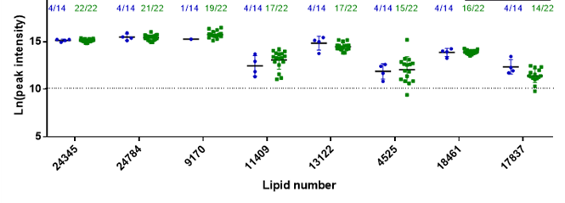
What to do with the zeroes
Most zeroes were due to low levels of that molecule generally, so could be removed without affecting the analysis.
A subset looked different…

Slide 47
Upshot…
You can have more than one type of data in your data!
In this case for some molecules there was an on/off which could be lost if the zeroes weren’t treated correctly.
This was important for the later choice of mixture models.

Slide 48
Basic steps of data pre-processing
Understand where your data have come from.
Look at your data graphically
Transform data as needed
Check and deal with missing values
See what needs to be a categorical value
Normalise
Now you have a dataset. Feel free to analyse at will

Slide 49
Basic steps of data pre-processing
Understand where your data have come from.
Look at your data graphically
Transform data as needed
Check and deal with missing values
See what needs to be a categorical value
Normalise
Now you have a dataset. Feel free to analyse at will

Slide 50
Normalising
Adjusting the data so that the distributions of the individual samples are matched and can be compared without bias caused by experimental, rather than patient, variation.
Many methods available.
Cheat: Normalyser package checks a number of methods
Quantile normalisation matches the maximum, minimum and quantiles of each sample with a theoretical distribution made up of all the samples in the experiment.
LOESS (locally weighted regression) is similar to quantile normalisation with the advantage of allowing local areas to be weighted. This can be important in data in which there are local causes of change.
Robust Linear Regression (RLR) matches the median of the sample to the median of the group or total data, then normalises the rest of the data by fitting it using a least squares method
Variance Stabilisation Normalisation (VSN) has a sliding scale of transformation of the data; it is similar to a logarithmic transformation for high intensity peaks, is similar to linear at low intensities and transitions smoothly between the two levels.
Total Intensity divides each reading by the sum of the values of all the peaks in the sample. It then scales the readings back up by multiplying by the median of the sum of all peaks in all samples and log2 transforms the data.
Median Intensity uses the same basic method, but in the first stage divides the samples by the median of the sample rather than the sum of the peaks.
Average Intensity same basic method again but uses the average of the readings rather than the total or median readings.

Slide 51
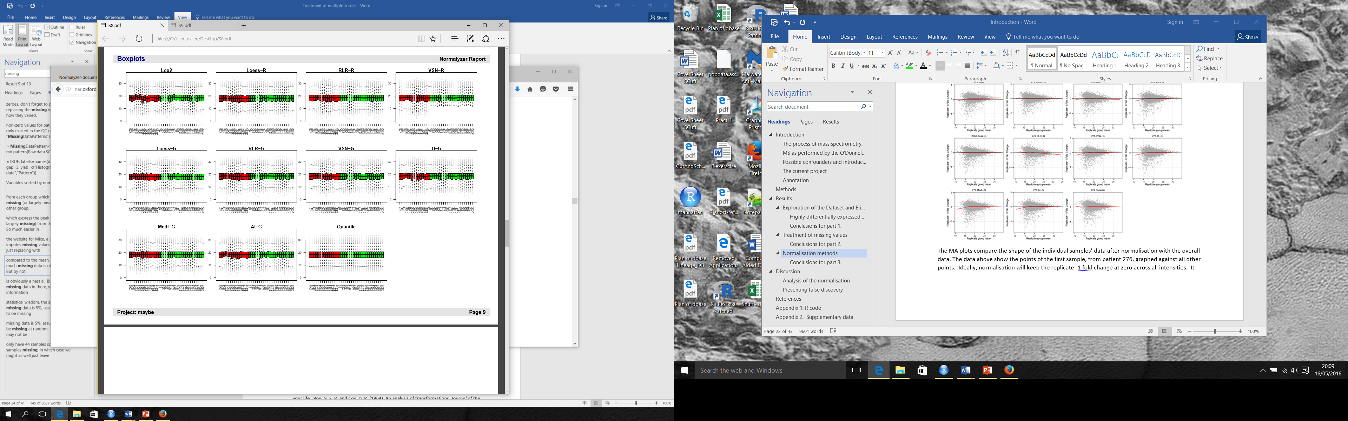

Slide 52
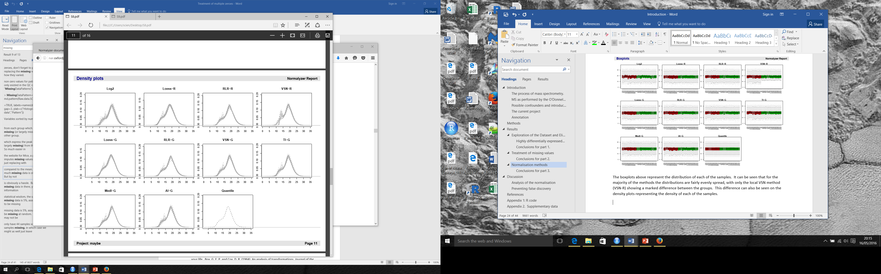

Slide 53
Basic steps of data pre-processing
Understand where your data have come from.
Look at your data graphically
Transform data as needed
Check and deal with missing values
See what needs to be a categorical value
Normalise
Now you have a dataset. You can begin your analysis.

